Slide 1
The Case for Nordic Institutions
Matt Bruenig, People’s Policy Project

Slide 2
Three Main Institutional Differences
The Nordic countries have much higher:
Union coverage
Social spending
State ownership

Slide 3
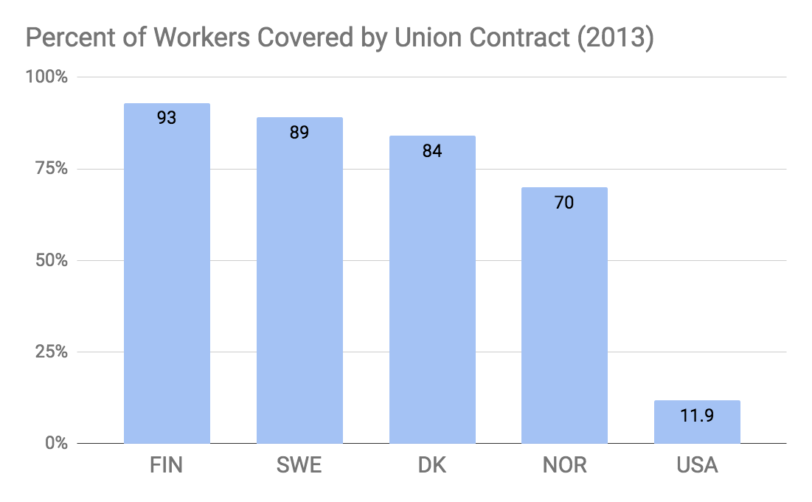

Slide 4
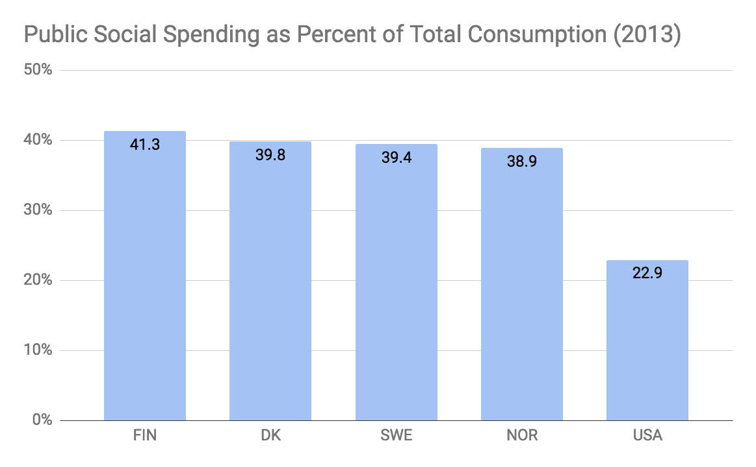

Slide 5
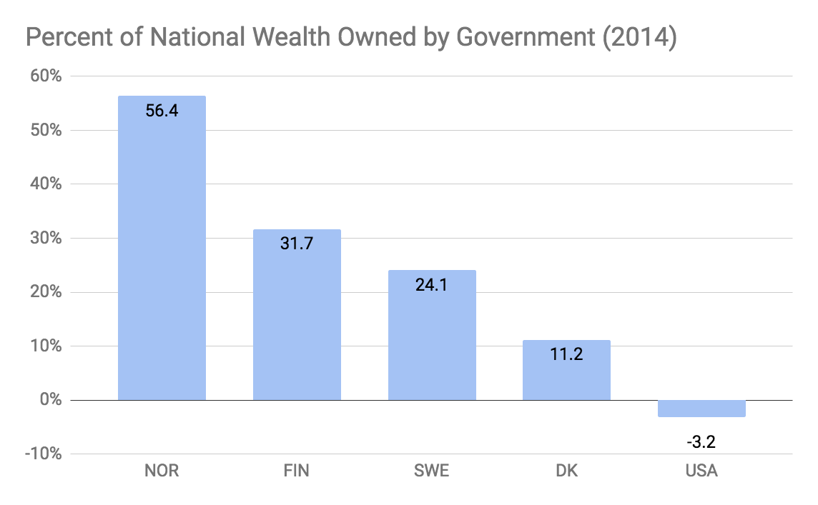

Slide 6
Result: Low Income Inequality
The Nordic countries have:
Smaller gaps between wage levels
Smaller gaps in disposable income
Lower poverty

Slide 7
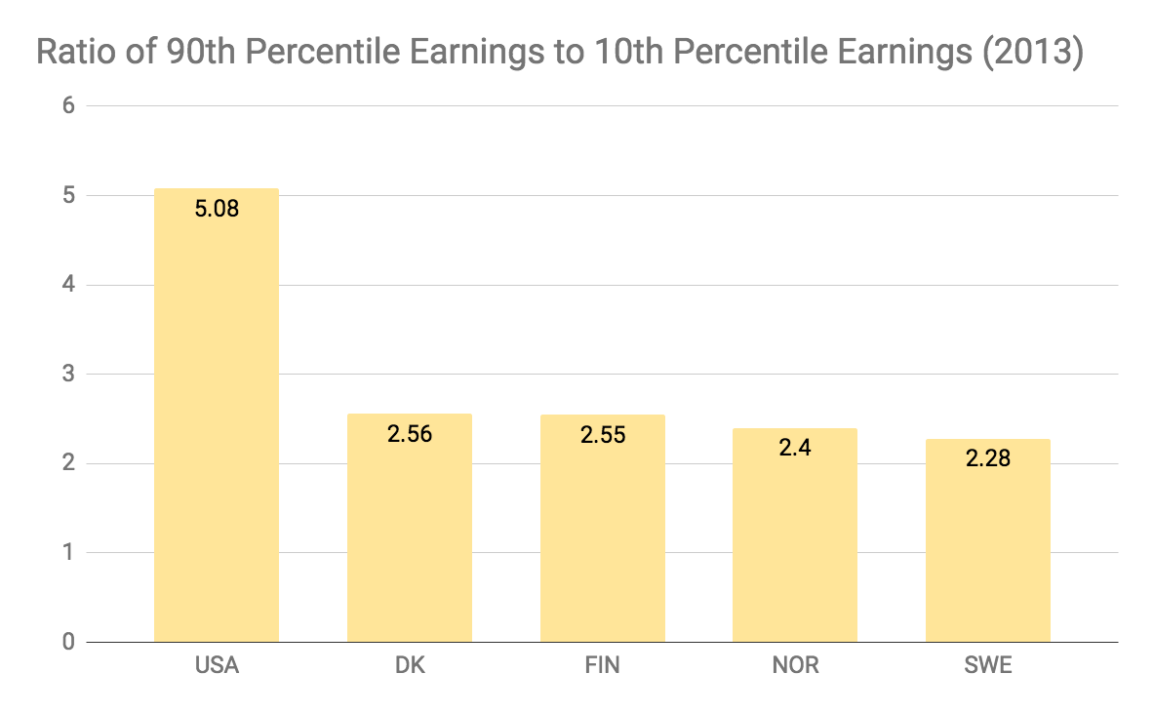

Slide 9
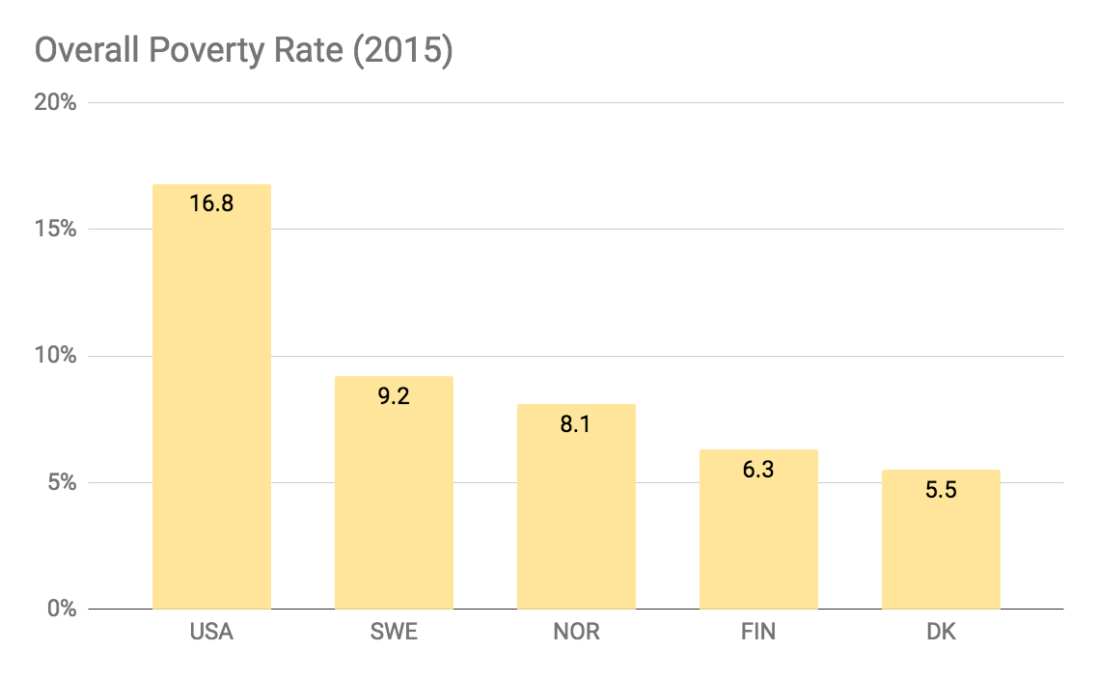

Slide 10
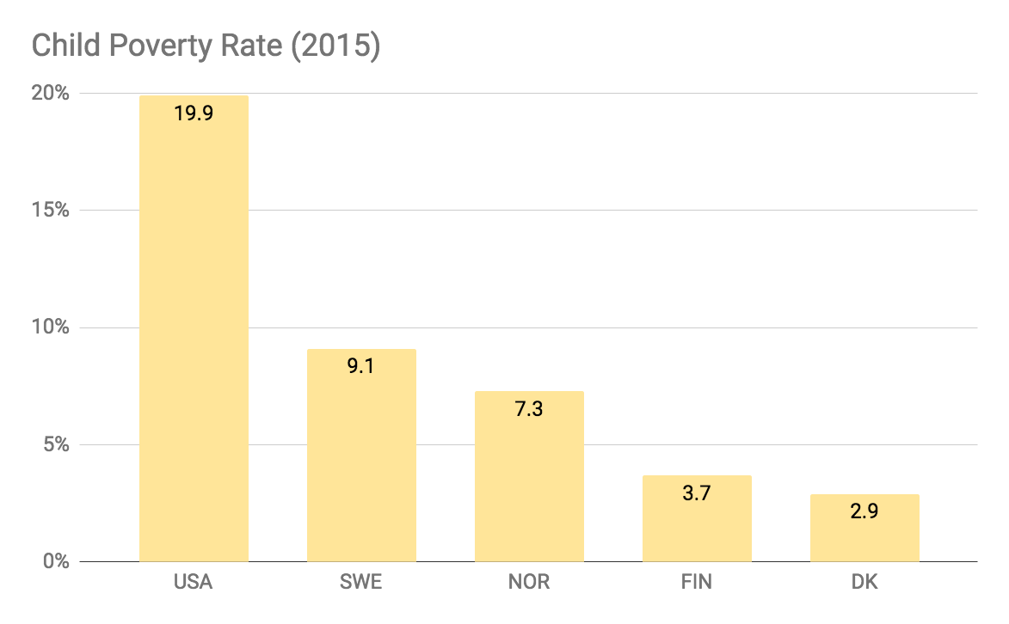

Slide 11
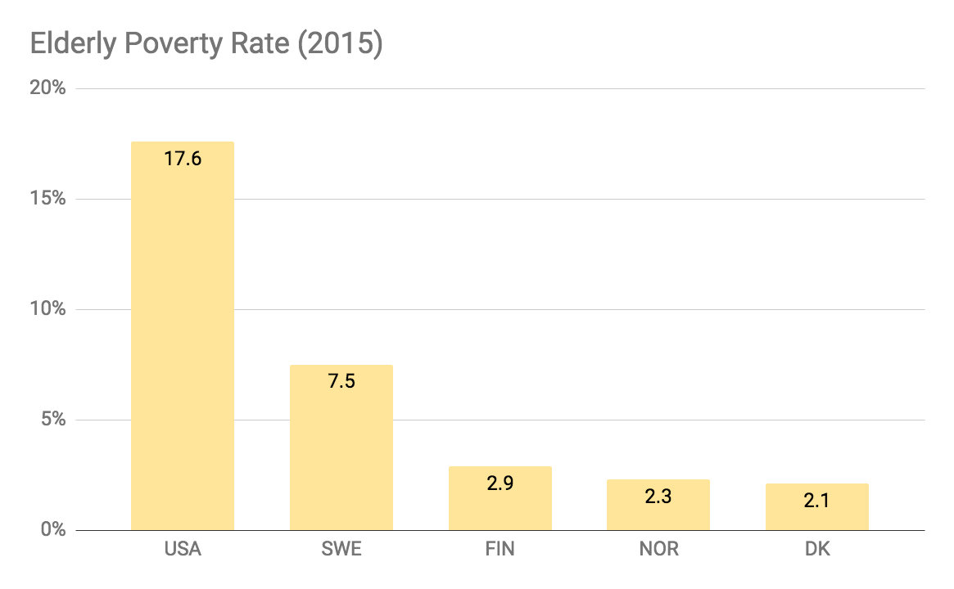

Slide 12
Result: Humane Work-Life Balance
The Nordic countries have:
More paid leave for new parents
More vacation
Fewer work hours

Slide 13
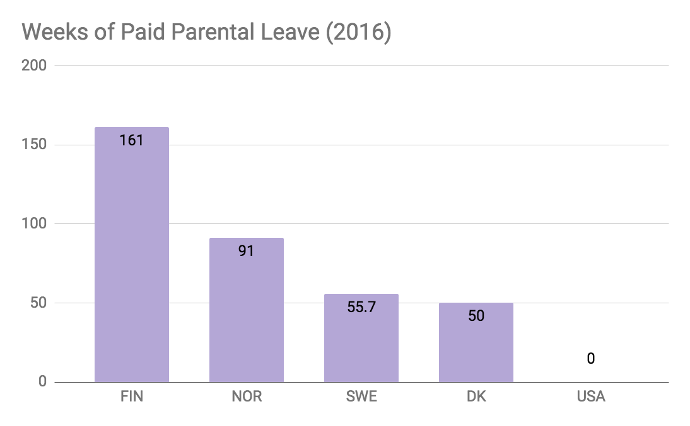

Slide 14
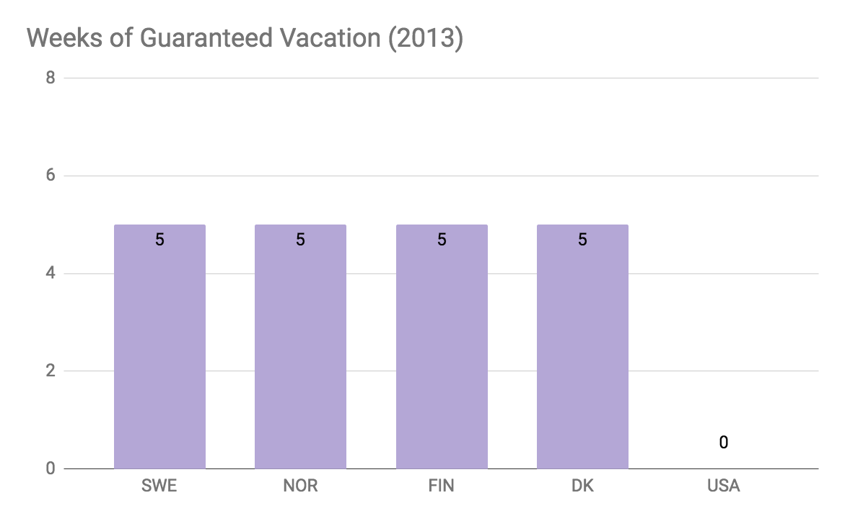

Slide 15
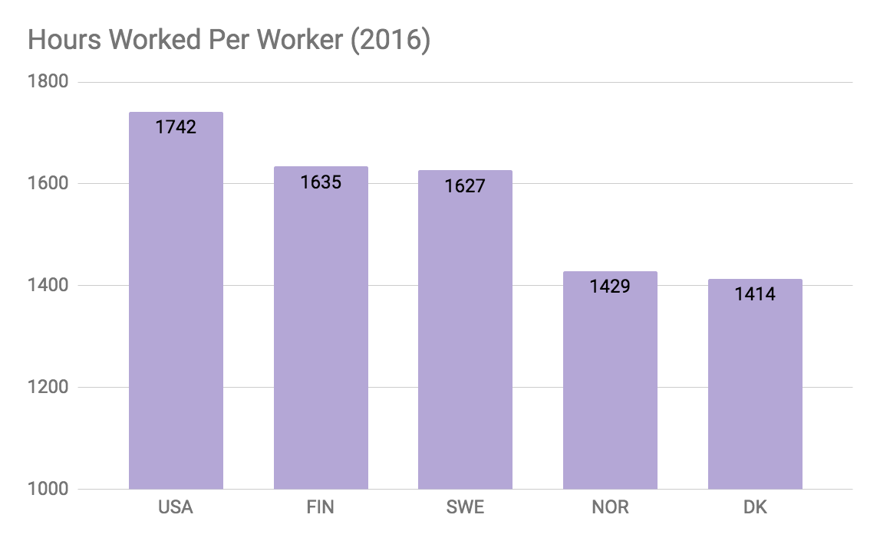

Slide 16
Result: High Growth
Nordic economies grow at least as fast as the US economy.

Slide 17
